Slide 1
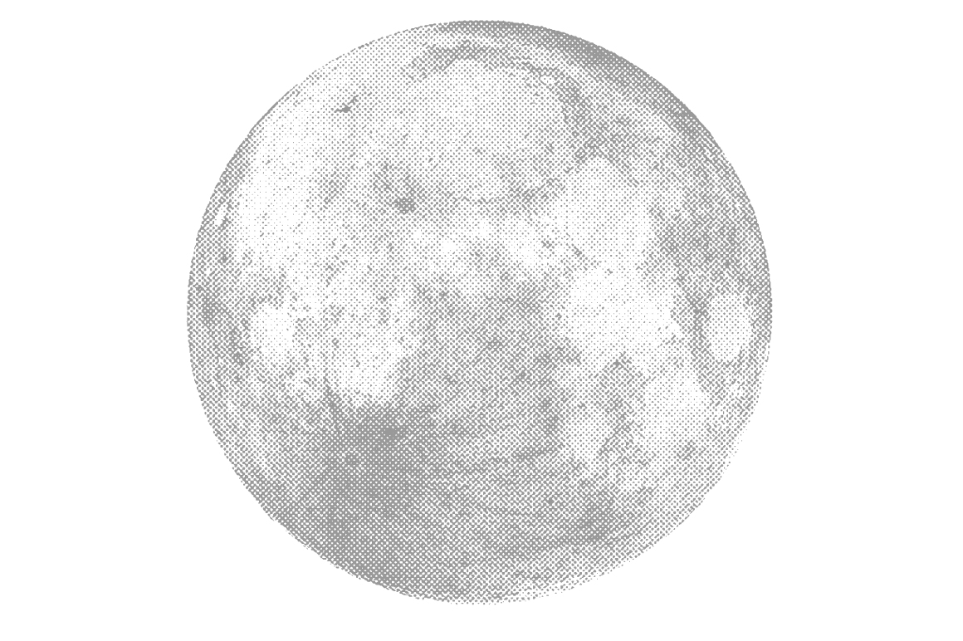




Microstructural Analysis to Determine
Space Weathering Rates in Mature Lunar Soils
Claudia Ramirez
Michelle Thompson
Lunar and Planetary Laboratory
Arizona Space Grant Symposium
The University of Arizona, Tucson, Arizona
April 16, 2016
(cloudfront.net)

Slide 2
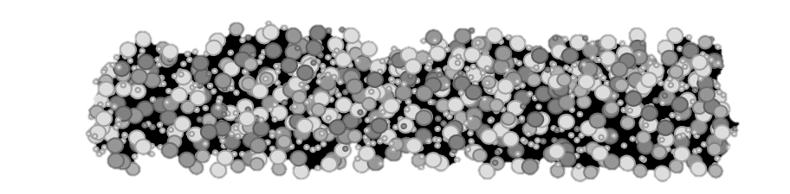

Introduction
Space weathering refers to processes that occur on airless bodies leading to changes in surface material
        Solar wind irradiation
        Micrometeorite impacts
Micrometeorites
Solar Wind
H⁺ and He⁺
Surface Soils

Slide 3
Introduction
Space weathering causes changes that affect crystal chemistry and microstructure
In lunar samples, evidence of space weathering is found in the formation of iron nanoparticles, or npFe
NpFe particles affect the spectral properties of material that we measure with remote sensing spacecraft
Understanding processes occurring on airless bodies provides insight to how planetary surfaces have evolved over time

Slide 4
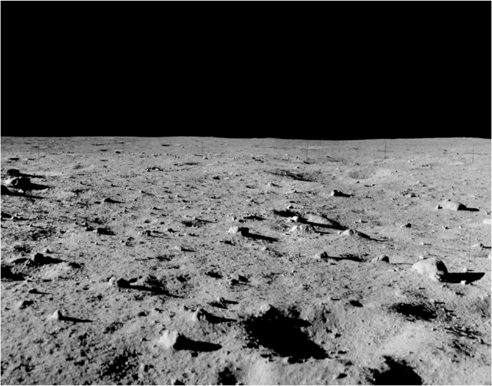
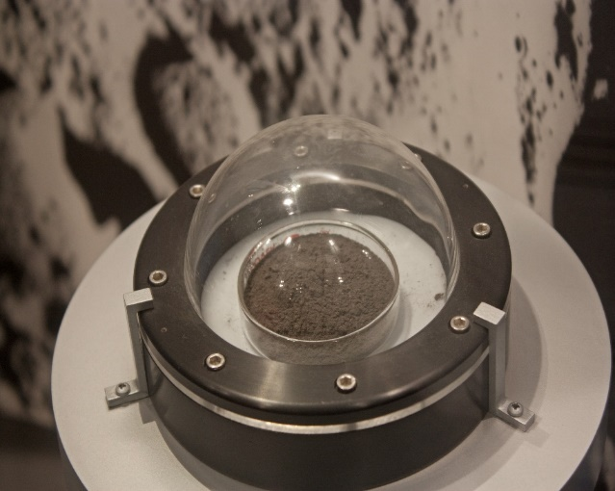
Objectives
Find how iron nanoparticle density and size distribution varies as a function of lunar soil maturity
npFe
(Philip Metzger)
(National Museum of Natural History)
Notes:
npFe varies as:
Size distribution varies as:
Yes that looks good. You will need to describe the image that they are looking at (a cross section of a grain, transmitting through the whole sample , this is a Z-contrast image….)

Slide 5
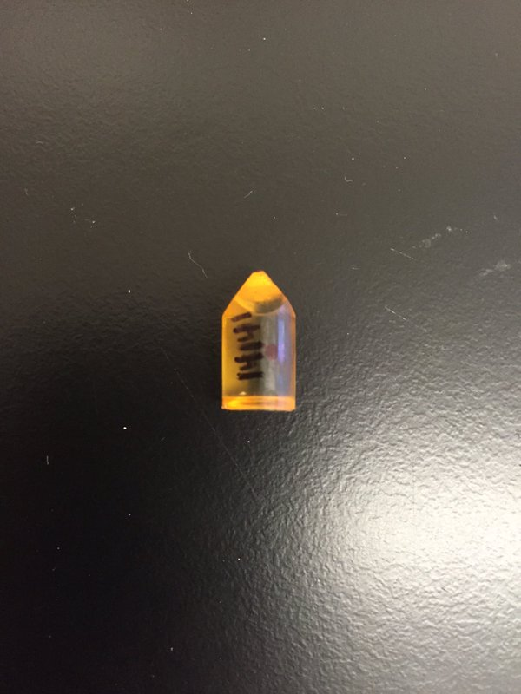
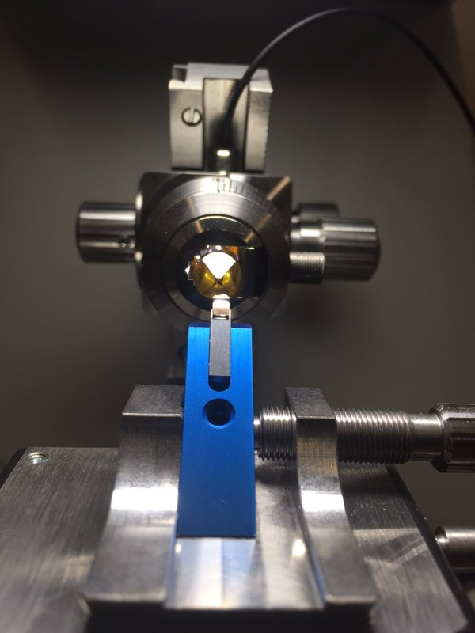
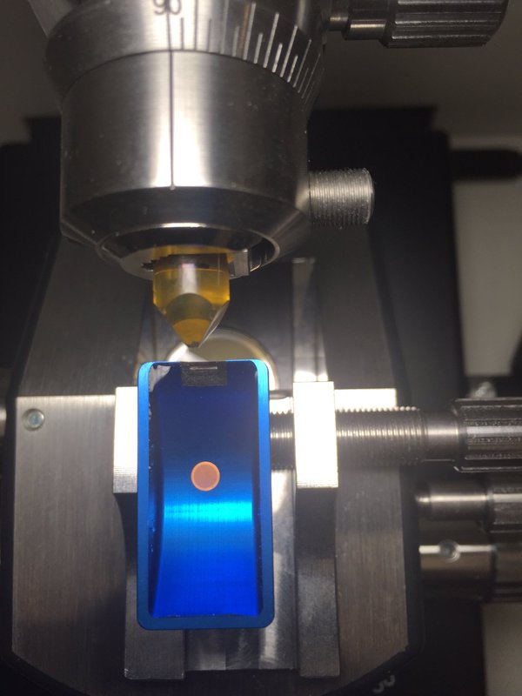
Methods and Materials
Four samples of lunar soils:
  79221 – a mature mare soil
  14259 – a mature highland soil
  61140 – a submature highland soil
  14141 – an immature highland soil
Embedded into a low viscosity epoxy and cured
Samples were trimmed and sliced using a microtome
Notes:
Discuss what maturity is
Explain what ultramicrotomy is

Slide 6
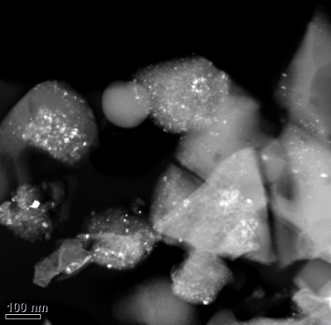
Methods and Materials
Sliced samples were analyzed using a TEM (Transmission Electron Microscope)
  The images were HAADF and Z-contrast, meaning the npFe appear bright because they have a high atomic number
npFe

Slide 7
Methods and Materials
Nanoparticle density was calculated using images, and using the section thickness to determine volume
  Grids were constructed according to the scale, and npFe counted in order to determine density

Slide 8
Results
Nanoparticle densities were calculated using the number of particles found per unit volume
The average npFe density for the soil 79221 was 6.8x10⁻⁷ nanoparticles/nm³ and for 14259 is 1.5x10⁻⁶ nanoparticles/nm³
The shape of the histograms in asymmetric, but there is no change between the shapes for highland and mare soils, despite different compositions

Slide 9
Conclusions
Based on preliminary findings, it has been observed that there are similar nanoparticle density and size distributions between highland and mare lunar soils
In the future, we will use the same methodology to measure the nanoparticle density and size distribution in immature and submature lunar soils for hundreds of individual grains in each sample
Nanoparticle densities found will be used in a landscape evolution model in order to find the rate at which space weathering occurs

Slide 10
Acknowledgements
Tom Zega, Lunar and Planetary Laboratory, The University of Arizona
Dolores Hill, Lunar and Planetary Laboratory, The University of Arizona

Slide 11
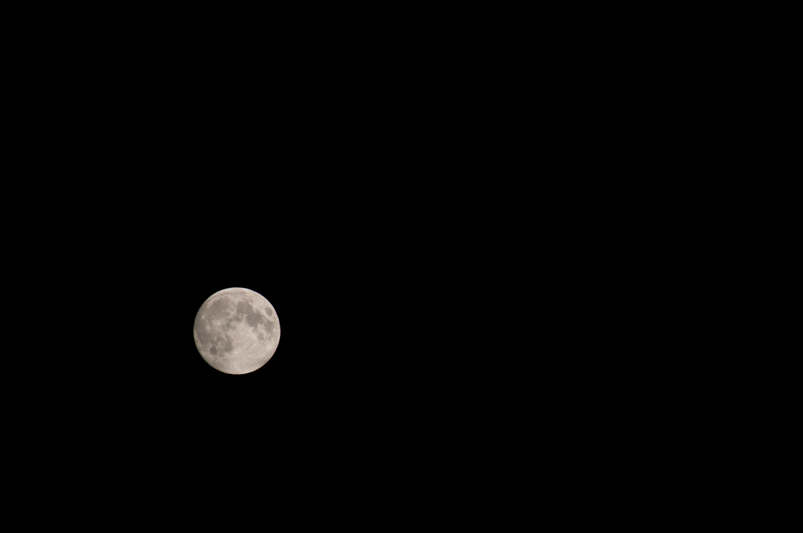
THANK YOU
(lumenatic)

